Slide 1
Detecting Spam Email through Machine Learning Optimized With Bio-Inspired Metaheuristic (Higher Level) Algorithm
Name - Pawan L Dhanani
Division - B
Roll number - 1911073

Slide 2
Introduction
Emails are used regularly by many people for communication and for socialising. Security breaches that compromises customer data allows ‘spammers’ to spoof a compromised email address to send illegitimate (spam) emails. This is also exploited to gain unauthorized access to their device by tricking the user into clicking the spam link within the spam email, that constitutes a phishing attack. Such problems can be solved by using Machine Learning. Machine learning makes it easier because it learns to recognise the unsolicited emails (spam) and legitimate emails (ham) automatically and then applies those learned instructions to unknown incoming emails.The proposed spam detection to resolve the issue of the spam classification problem can be further experimented by feature selection or automated parameter selection for the models. This research conducts experiments involving multiple machine learning models with Particle Swarm Optimization (PSO) and Genetic Algorithm (GA).

Slide 3
Objectives
The paper aims to achieve the following objectives :
1) To explore machine learning algorithms for the spam detection problem 2) To investigate the workings of the algorithms with the acquired datasets 3) To implement the bio-inspired algorithms 4) To test and compare accuracy of base models with bio-inspired implementation 5) To implement the framework using Python

Slide 4
Tools and Techniques
WEKA : WEKA is a GUI tool that allows to load a dataset and apply different functions/rules upon an algorithm.
Scikit-Learn : An environment incorporated with Python and has wide range of algorithms.
Keras : An API that supports Neural Networks used for learning and development.
TensorFlow : An ML platform developed by Google that can be incorporated with Kera.
Python Platforms : Spyder and Jupyter Notebook are IDE’s that can be used too.

Slide 5
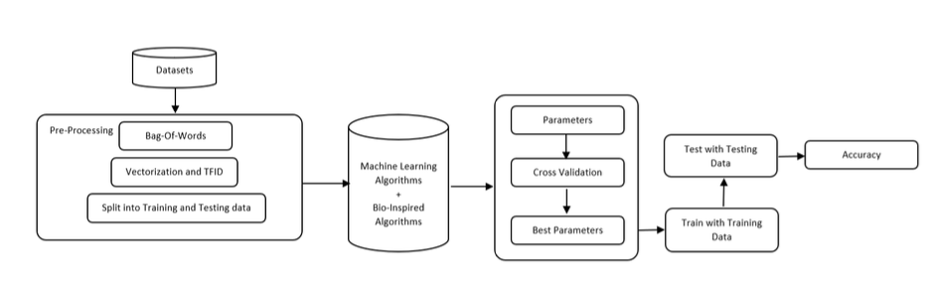
SPAM DETECTION BLOCK ALGORITHM

Slide 6
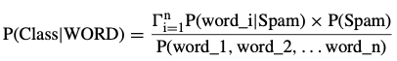
Machine Learning Models
Naive Bayes - Multinomial (NBM) :
Equation : P(CLASS|WORD) = (P(WORD|CLASS) * p(CLASS))/P(WORD)
Where WORD is (word₁, word₂,...) and CLASS is either “Spam” or “Ham”.
IF CLASS = Spam, then

Slide 7
2. SUPPORT VECTOR MACHINE (SVM) :
This algorithm plots each node from a dataset within a dimensional plane and through classification technique the cluster of data is separated by a hyperplane into their respective groups. The hyperplane can be described as equation :
H = VX + c,
where c is a constant and V is the vector.
Stochastic Gradient Descent classifier (SGD) is loaded from Scikit-learn library is loaded. It is an optimized version of SVM as SVM cannot work with large dataset.
The algorithm uses the learning rate to iterate over the sample data to optimize the Linear algorithm and it is denoted by the following equation for the default learning rate as
’Optimal’:1/α(t0 + t),
where t is the time step which is acquired by multiplying number of
iterations with number of samples(Emails).

Slide 8
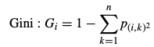
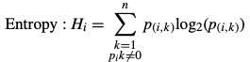
3. DECISION TREE CLASSIFIER (DTC) :
The Decision Tree model is based on the predictive method. The model creates a category which is further distributed into sub-categories and so on. The algorithm runs until the user has terminated or the program has reached its end decision. The model predicts the value of the data by learning from the provided training data.
Gini calculates the incorrectly labelled data that was selected randomly :
Entropy is based on information gain based on the selected attributes :
, where P is the probability and i is a node.

Slide 9
4. RANDOM FOREST CLASSIFIER (RFC) :
The algorithm predicts the classes by using multiple decision tree, where each tree predicts the classification class. This is evaluated by the RF model to select the high number of predicted class as an assigned prediction.
The equations used are same as that in Decision Tree Classifier i.e Gini and entropy.
If the depth of the tree is more, more computational time is required for the algorithm to be executed.

Slide 10
5. MULTI-LAYER PERCEPTRON (MLP) :
The MLP is a feed-forward Artificial Neural Network (ANN). It is a supervised method which includes non-linear hidden layers between the input and the output layer. The algorithm works with the linear activation function on a training dataset set by default known as
Hyperbolic Tan f(·):Rm →Ro , where m is the input (spam words in this case) and o is the number of outputs from the function. The algorithm can have one or more layers between input and output layer known as Hidden Layer. The hidden layer accepts the values from the previous layer and transforms with linear summation, whereas the ‘Output’ layer provides the output values after transformation from the previous hidden layer.

Slide 11
REQUIREMENTS
A. ADDING CORPUS : Load testing and training datasets (both spam and ham).
B. TOKENIZATION : Sentences are broken into words/tokens and occurrence of certain words can help the algorithm to predict if the email is spam.
C. FEATURE EXTRACTION AND STOP WORDS : Certain words are removed as they are unnecessary and not helpful in detecting if the email is spam or not.
D. MODEL TRAINING AND TESTING PHASE : Trained with a known dataset and tested with an unknown datasets helps in checking the predictability of the algorithms.
E. DATASETS : Publicly available datasets such as Ling-Spam, PU, Enron and SpamAssassin were used in this research paper.
F. SOFTWARE AND HARDWARE : Python 3.4 or above can be used alongwith Spyder or Jupyter IDE.
G. LIBRARIES AND MODULES : Scikit-Learn was used as it offered a vast majority of the ML libraries and dataset processing modules.

Slide 12
PERFORMANCE MEASURES
A. CONFUSION MATRIX : Confusion Matrix is being used to visualise the detection of the emails for models. Confusion matrix can be defined as below :
1) TN = True Negative – Ham email predicted as ham
2) TP = True Positive – Spam email predicted as spam
3) FP = False Positive – Spam email predicted as ham
4) FN = False Negative – Ham email predicted as spam
 | HAM | SPAM
HAM | TN | FP
SPAM | FN | TP

Slide 13
PERFORMANCE MEASURES
B. ACCURACY : “Accuracy” module from Scikit-learn helped in predicting accuracy.
Accuracy = (TN + TP) / ( TN + FN + TP + FP)
C. RECALL : Calculates how many emails were spam from given number of spam emails.
Recall = TP / (TP + FN)
D. PRECISION : Number of emails predicted positive from total number of positives.
Precision = TP / ( TP + FP)
E. F1-SCORE : Harmonic mean of precision and recall values.
Fβ = (1 + β²)(precision × recall) / (β² × (precision + recall))

Slide 14
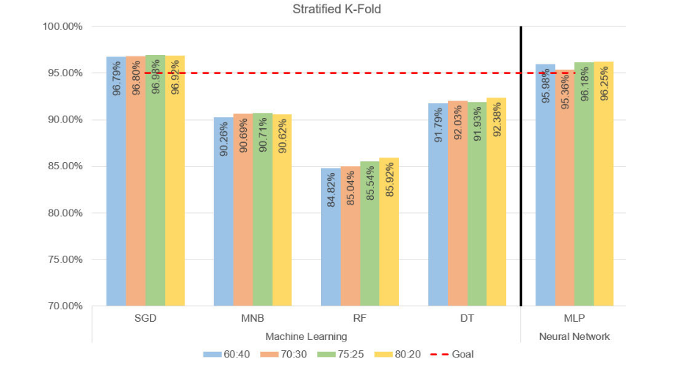
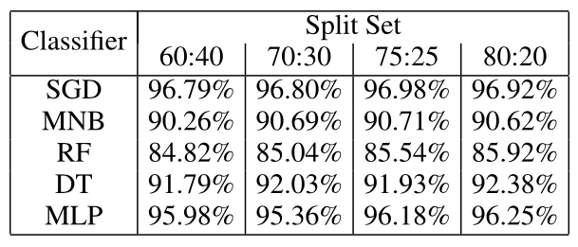
RESULTS OF BASE MODEL ON DATASETS
Stratified K-Fold Cross Validation (SKFCV) was
applied to all the ML models.
According to this graph, SGD had the
highest accuracy whereas RF had
the lowest.
7 datasets were used. All of them provided more than 90% accuracy after calculating the average except RF.

Slide 15
TUNING OF PARAMETERS
A. SGD PARAMETERS : Hyperparameter tuning the algorithm offers 3 parameters from the SGD algorithm: Alpha values, Epsilon values and Tol values for the search space. Values for all three keys ranged from 0.0001 to 1000 as a dictionary.
Alpha: The variable could help set the optimal learning rate. It is also classed as the constant for regularization term. Epsilon: This value determines the learning rate for the algorithm. Tol: This is the criteria for termination.

Slide 16
B. MNB PARAMETERS : The dictionary of parameters provided for the optimization were values of :
Alpha: This is used as a smoothing parameter for Laplace or Lidstone to the raw counts. This parameter will be passed as a float for PSO. This is combined with the number of features within the module. The value ranged from 0.0001 to 1000 as a dictionary. Fit Prior: This is to learn the class probabilities.
C. RF PARAMETERS : The dictionary of parameters provided for the optimization were values of :
Number of estimators: This state's number of trees in the forest. Max depth: This indicated maximum depth of the tree. Minimum leaf sample: Specifies the minimum number of leaves at the leaf node. Criterion: This is in a string format. This is a tree specific parameter that can be ‘Gini’ for Gini impurity or ‘Entropy’ for information gain.

Slide 17
D. DT PARAMETERS : The dictionary of parameters provided for the optimization were values of:
Splitter: This is a string-based parameter which can be either ‘Best’ or ‘Random’. This specifies the strategy for the split at a node. Max Depth: This will specify the depth of the tree. Criterion: This measures the quality of the split. Minimum leaf sample: This is passed as an integer to specify the minimum number of samples that are necessary at the leaf node. E. MLP PARAMETERS : The dictionary of parameters provided for the optimization were values of :
Hidden layer sizes: Number of neurons to be considered by the classifier. This is where each feature is interconnected with each neuron. Alpha: This is a regularization parameter. The value was ranged from 0.001 to 0.01. These values were less than the default value. Solver: According to the Scikit-learn documentation, the solver when set to ‘LBFGS’, the module’s performance and speed can increase on small datasets.

Slide 18
BIO-INSPIRED OPTIMIZATION ALGORITHMS
A. PARTICLE SWARM OPTIMISATION : PSO is based on swarming methods of birds or fishes. Particles are evaluated based on their best position and global position.
The ‘global_best’ module and equation denotes the updating of each particle position:
xi(t + 1) = xi(t) + vi(t + 1)
where xi is the position of the particle, t is the current timestamp and t + 1 is the computed velocity which gets updated. The velocity (vi) can be further defined as below :
vij(t + 1) = w × vij(t) + c1r1j(t)[yij(t)−xij(t)] + c2r2j(t)[yˆj(t) − xij(t)]
where r1 and r2 are the random numbers, c1 is the cognitive parameter and c2 is the social parameter. These parameters control the behaviours of the particle. The w is the inertia parameter that controls the swarm’s movements, which is the important parameter and hence the value is bigger than the other parameters. The parameters for cognitive and inertia parameter remained with default value as the demonstrated algorithm in

Slide 19
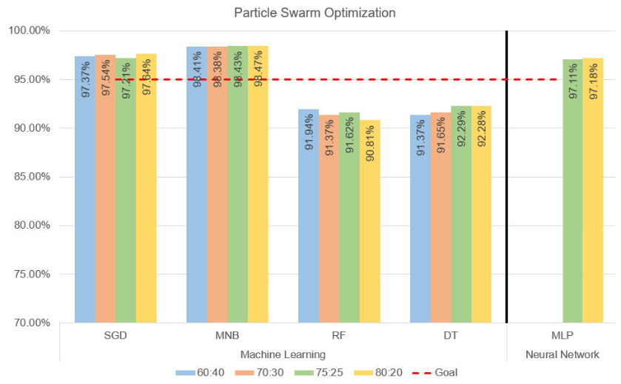
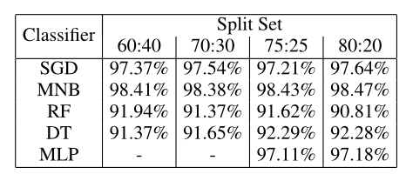
All the models showed more than 90%
accuracy using PSO. MNB showed the
highest accuracy (98.47%) whereas RF
showed the lowest accuracy (90.81%).

Slide 20
BIO-INSPIRED OPTIMIZATION ALGORITHMS
B. GENETIC ALGORITHM : It is an evolutionary algorithm based on Darwinian natural selection. The algorithm maintains a population size and the individuals have a unique number that are binary represented. The algorithm then iterates through a fitness function where best individuals are selected for reproduction of offspring. Higher the fitness, higher the probability. Parameters like mutation rate and crossover rate should be taken into consideration where the sum of both should not exceed 1.

Slide 21
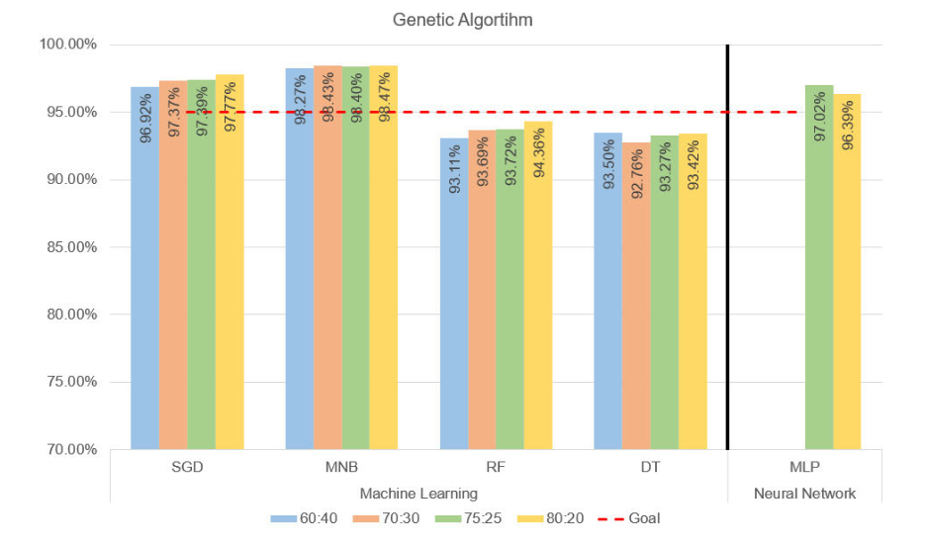
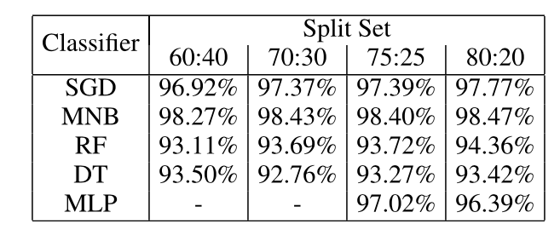
All the models showed more than 90%
accuracy using PSO. MNB showed the
highest accuracy (98.47%) whereas RF
showed the lowest accuracy (93.11%).

Slide 22
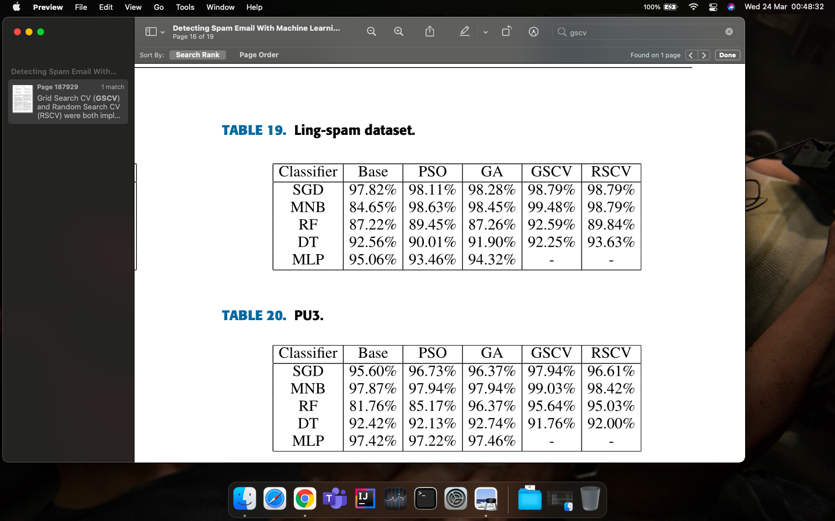
EVALUATION AND COMPARISON
The table also compares with the optimization models that is provided by the Scikit-learn library. Grid Search CV (GSCV) and Random Search CV (RSCV) were both implemented within the base model and were loaded from the Scikit-learn library.
1. Ling-Spam Dataset :

Slide 23

2. PU Dataset :
3. SpamAssassin Dataset :
4. Enron Dataset :

Slide 24
EVALUATION AND COMPARISON
MNB showed the highest accuracy.
RF had the lowest accuracy.
Computational cost and execution time for PSO is lower than GA but GA produced higher accuracy than PSO.
MNB when combined with GA produced the highest accuracy.

Slide 25
CONCLUSION
The project successfully implemented models combined with bio-inspired algorithms. The spam email corpus used within the project were both numerical as well as alphabetical. Approximately 50,000 emails were tested with the proposed models.
Genetic Algorithm worked better overall.
The PSO worked well for Multinomial Naïve Bayes and Stochastic Gradient Descent, whereas GA worked well for Random Forest and Decision Tree.
Naïve Bayes algorithm was proved to have been the best algorithm for spam detection.
Other bio-inspired algorithms like Ant or Bee colony optimization can be used.

Slide 26
STRATEGY TO IMPLEMENT
Various algorithms are given for the ML models in the research paper along with the bio-inspired algorithms. There are free datasets available online like SpamAssassin that can be used as a training set / testing set.
Python 3.4 or above can be used with Jupyter or Spyder which are incorporated within the Anaconda framework.
Scikit-learn is an environment that can be used as it has various ranges of algorithms and can perform cross validation and parameter tuning.

Slide 27

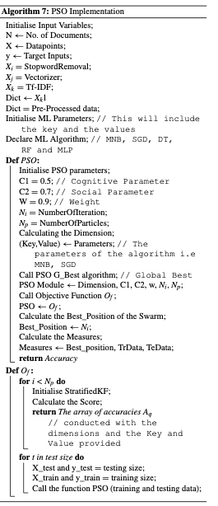

Slide 28
Bibliography
https://ieeexplore.ieee.org/stamp/stamp.jsp?tp=&arnumber=9222163
GeeksforGeeks. (2019). Naive Bayes Classifiers-GeeksforGeeks. Accessed: Nov. 10, 2019. [Online]. Available: https://www.geeksforgeeks.org/naive-Bayes-classifiers/
https://www.sciencedirect.com/topics/engineering/particle-swarm-optimization
S. Sharma and A. Arora, ‘‘Adaptive approach for spam detection,’’ Int. J. Comput. Sci., vol. 10, no. 4, pp. 23–26, 2013. [Online]. Available: https://ijcsi.org/papers/IJCSI-10-4-1-23-26.pdf
https://www.tutorialspoint.com/genetic_algorithms/genetic_algorithms_introduction.htm#:~:text=Genetic%20Algorithm%20(GA)%20is%20a,take%20a%20lifetime%20to%20solve.

